Slide 1
Cars365
New Thinking, New Possibilities
Gowtham T (19z214)
Indra Shekar G (19z219)
Sanjai M(19z241)
Soumen Saha (19z245)
Manoj S (19z263)
Mathana Sekaran T (19z264)

Slide 2


Table of Contents
Introduction
Problem statement
Objective
01
02
03
System Req
Req Gathering
Design
04
05
06
Here, we give a brief note on area of project
Here, we will discuss about why we took this project
Here, we will explain what we have worked on
Here, we will discuss on software and hardware reqs
Here, we will say about the modules we have used
Here, we explain the use case and system architecture

Slide 3

Introduction
The Cars365 online platform maintains and views information of buyers and sellers details, number of available cars for sales, location and prices. This project serves as a prototype for a car trading online platform and it is intended for used car sellers and buyers.

Slide 4
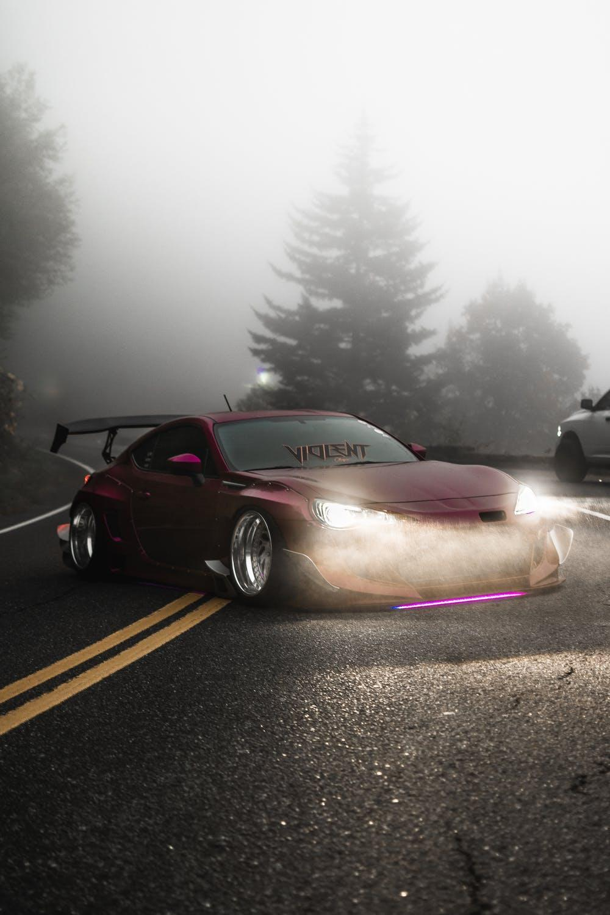
Problem Statement
With the ongoing pandemic, the already emerging challenges of automobile industry have turned to a crisis. Amid the digitalization, online trading seems the most sensible way to connect sellers and buyers from home. To create a platform which caters to all required services of car trading is the thing our project going to address.

Slide 5

Objective
The purpose of the cars365 online platform is to ease car trading and to create a convenient and easy-to-use application for car buyers and sellers. The system is based on a database with its buy, sell, rental and price prediction functions. It is consumer focused services that include content and tools for research, pricing, and marketplace information. Cars365 offers a platform where car buyers and owners can research, buy, sell and discuss cars.. Above all, we hope to provide a comfortable user experience along with convincing price predictions available.

Slide 6




System Requirements
04
Back-End
Node JS, MongoDB, Python
03
Front-End
Html, CSS, JavaScript
02
Software
Any Browser which can browse through internet
01
Hardware
Any PC configuration which has access to internet

Slide 7

Requirements Gathering
Bootstrap
Frontend Frameworks and modules used
Bootstrap includes HTML and CSS based design templates for typography, forms, buttons, tables, navigation, models, images carousels and many other, as well as optional JavaScript plugins
jQuery
jQuery is a fast, small, and feature-rich JavaScript library. It makes things like HTML document traversal and manipulation, event handling, animation simpler with an easy-to-use API that works across all the browsers

Slide 8


Express
Ejs
Node Js
Mongoose
Multer
Express is a minimal and flexible Node.js web application framework that provides a robust set of features for web and mobile applications.
EJS (Embedded JavaScript) is a simple templating language that lets you generate HTML markup with plain JavaScript.
Mongoose is used to work with mongo dB database with very simple syntax and provides a straight-forward, schema-based solution to model your application data.
Multer is a node.js middleware for handling multipart/form-data, which is primarily used for uploading files.

Slide 9
Node Js
Body-Parser
This module Parses incoming request bodies in a middleware before your handlers. It can parse Json, Text and many other formats
Dotenv
Dotenv is a zero-dependency module that loads environment variables which contains sensitive information's like api keys or database connection links, Id’s etc.

Slide 10
Main Functionalities of our system
Buyers Portal:
This portal provides an interface for buyers who are searching used cars to buy and through this, they can connect to the sellers using the provided contact information.
Sellers Portal:
This portal provides an interface for the sellers who can upload their cars’ photos and information so that their cars can be posted on the buyers page.
Rental Portal:
This page is for the users who wish to rent cars for a certain period of time.

Slide 11
Car price predictor:
The car price predictor is a ML model which predicts the prices of the used cars based on the data provided by the sellers.
Popular cars dashboard and visualizations:
This dashboard provides useful charts and tables of car sales and trends of buyers and sellers.
Cars auctioning:
Auctioning page is for the vintage car sellers who can post their cars and conduct real time auctions.

Slide 12
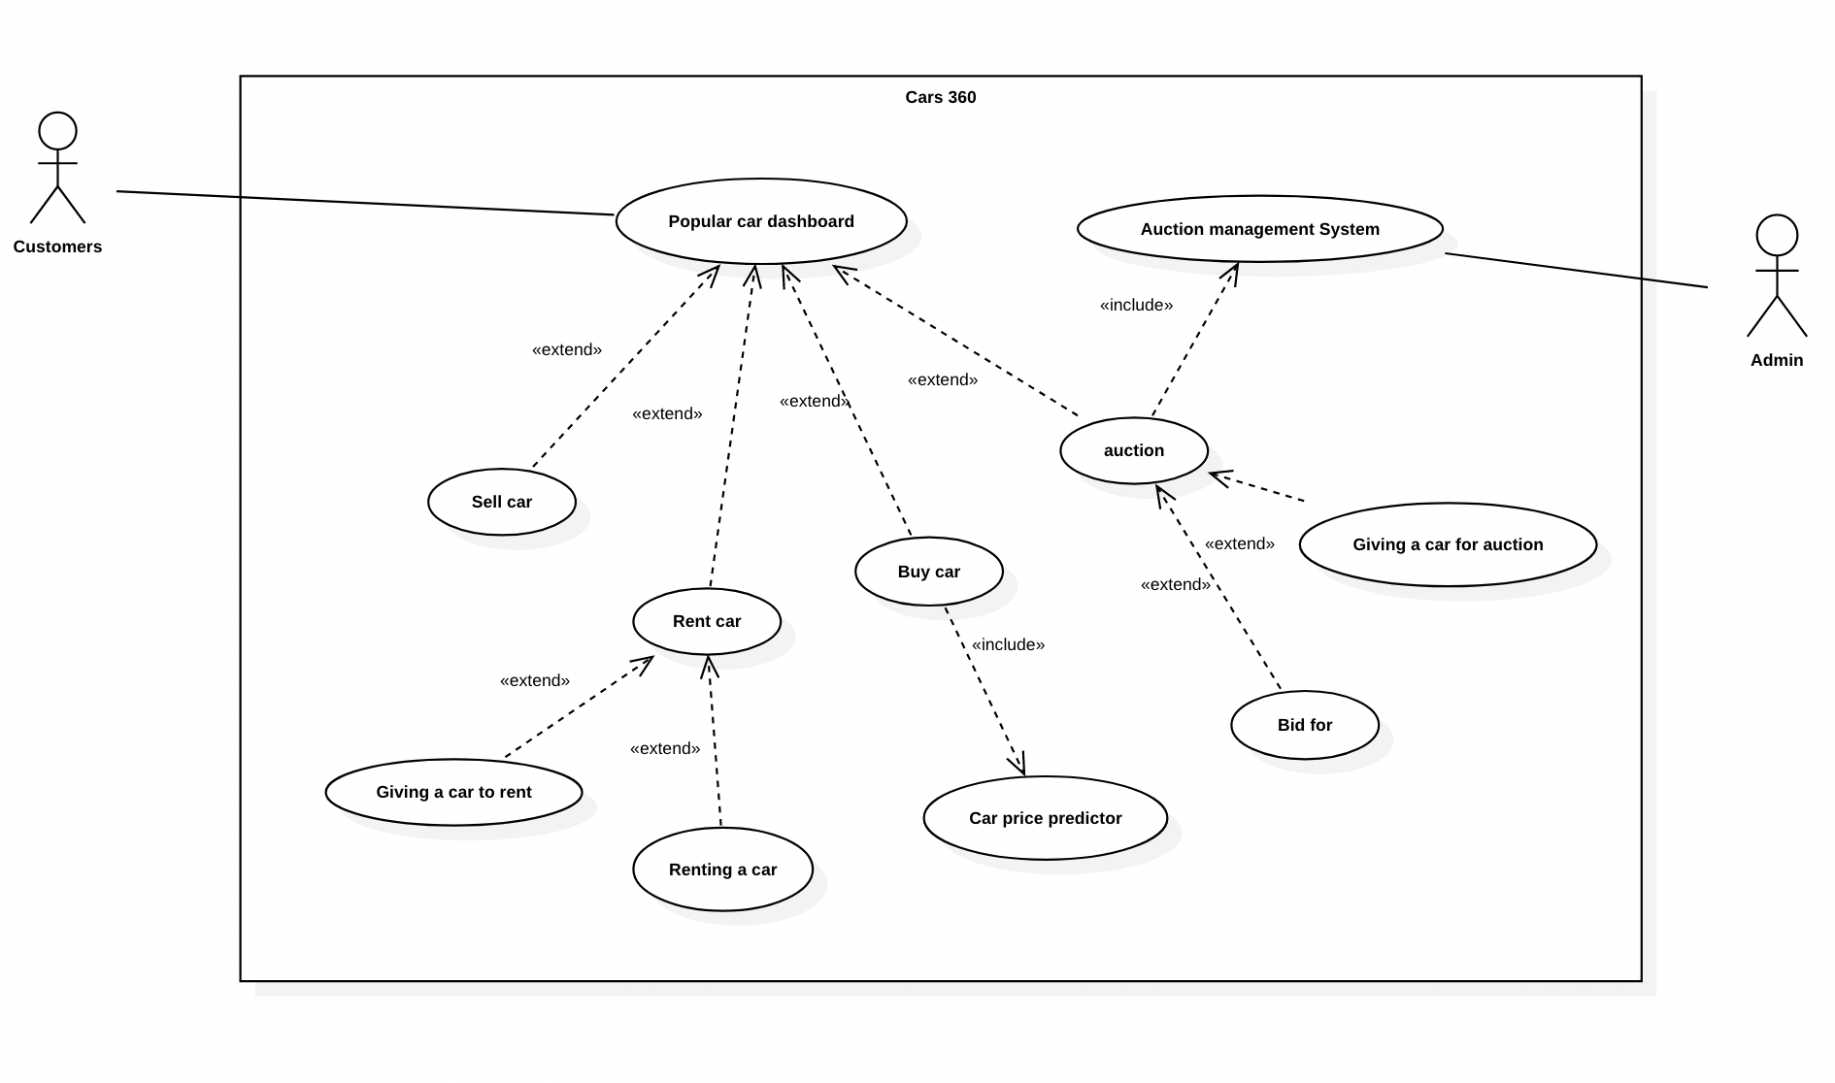
Design
Use Case Diagram

Slide 13
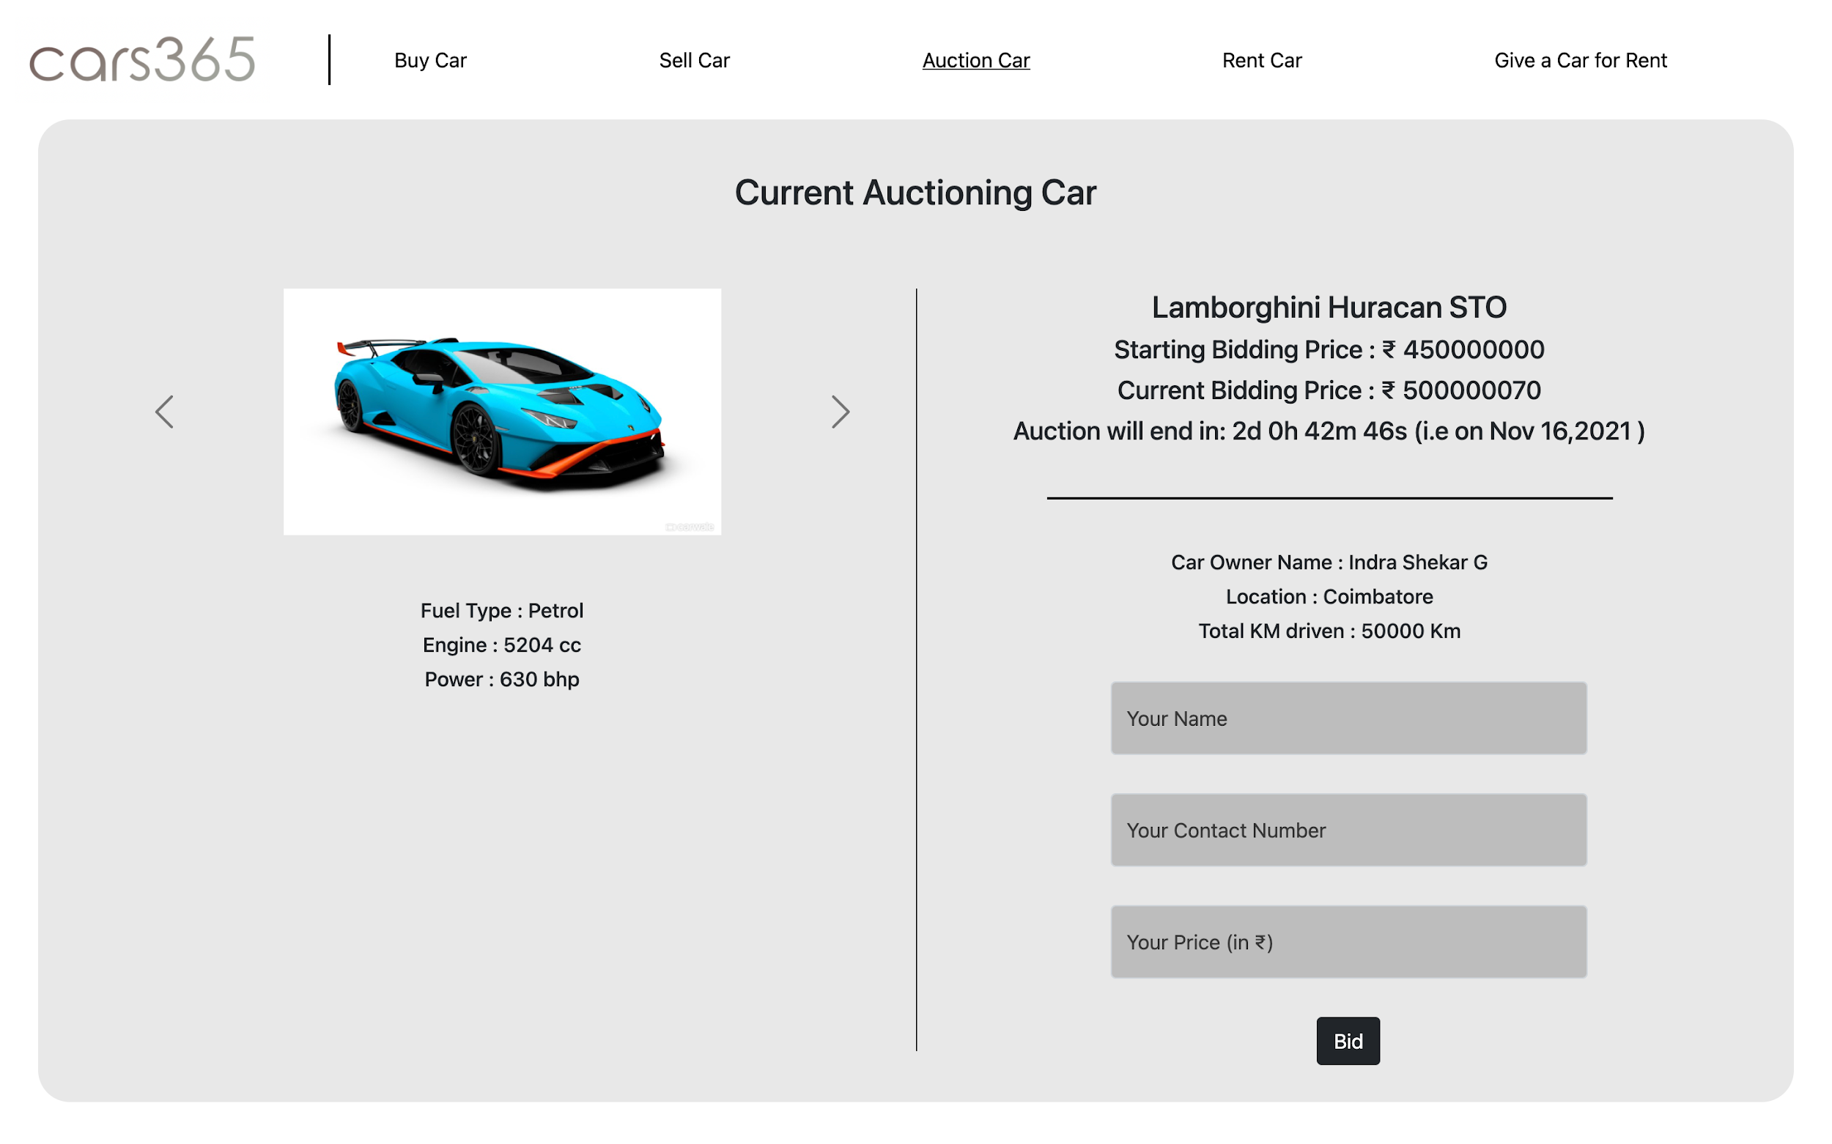
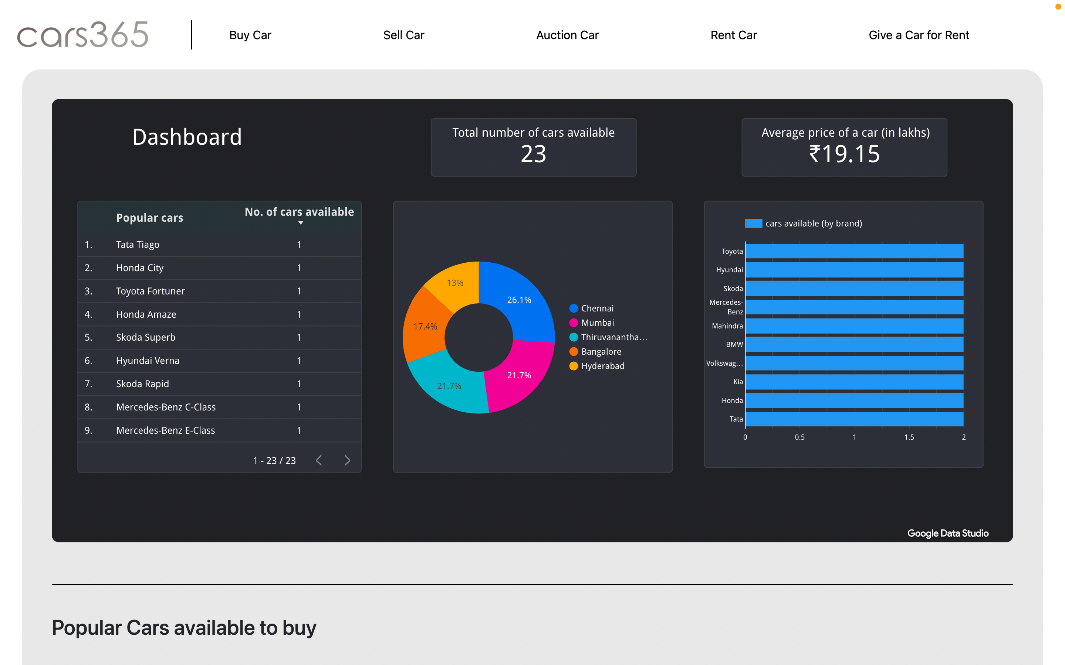
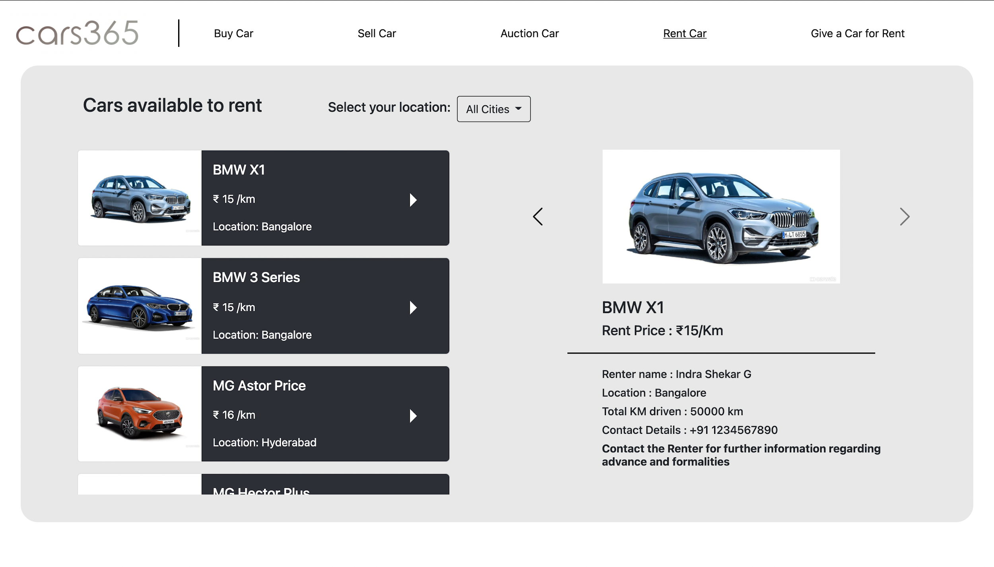
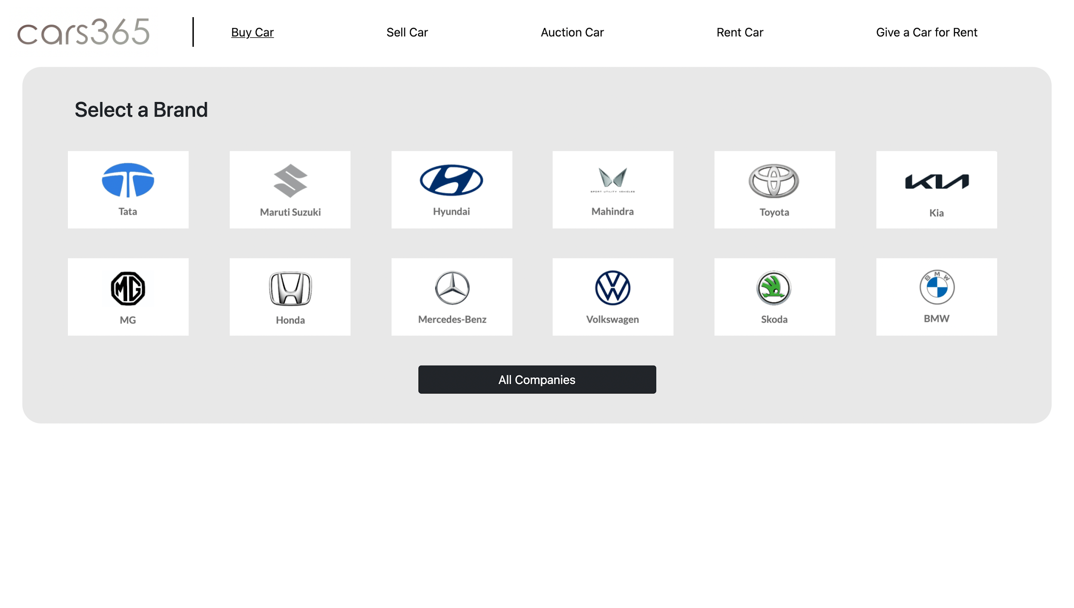
Sneak Peek

Slide 14
Contribution
Gowtham T (19z214) – Admin Portal server programming
Indra Shekar G (19z219) – Main App server programming
Sanjai M(19z241) – Price predictor and dashboard
Soumen Saha (19z245) – Main App Database Management
Manoj S (19z263) – Frontend Integrations (EJS)
Mathana Sekaran T (19z264) – Admin Portal Database management

Slide 15
Demo

Slide 16
Thank you

